Slide 1
Dynamic programming
Matrix-chain Multiplication

Slide 2
Matrix-chain Multiplication - 1
Suppose we have a sequence or chain A₁, A₂, …, A_{n} of n matrices to be multiplied
  That is, we want to compute the product A₁A₂…A_{n}
There are many possible ways (parenthesizations) to compute the product

Slide 3
Matrix-chain Multiplication - 2
Example: consider the chain A₁, A₂, A₃, A₄ of 4 matrices
  Let us compute the product A₁A₂A₃A₄
There are 5 possible ways:
  (A₁(A₂(A₃A₄)))
  (A₁((A₂A₃)A₄))
  ((A₁A₂)(A₃A₄))
  ((A₁(A₂A₃))A₄)
  (((A₁A₂)A₃)A₄)

Slide 4
Matrix-chain Multiplication - 3
To compute the number of scalar multiplications necessary, we must know:
  Algorithm to multiply two matrices
  Matrix dimensions
Can you write the algorithm to multiply two matrices?

Slide 5
Algorithm to Multiply 2 Matrices
Input: Matrices A_{p×q} and B_{q×r} (with dimensions p×q and q×r)
Result: Matrix C_{p×r} resulting from the product A·B
MATRIX-MULTIPLY(A_{p×q} , B_{q×r})
1. for i ← 1 to p
2. for j ← 1 to r
3. C[i, j] ← 0
4. for k ← 1 to q
5. C[i, j] ← C[i, j] + A[i, k] · B[k, j]
6. return C
Scalar multiplication in line 5 dominates time to compute C. Number of scalar multiplications = pqr

Slide 6
Matrix-chain Multiplication - 4
Example: Consider three matrices A_{10×100}, B_{100×5}, and C_{5×50}
There are 2 ways to parenthesize
  ((AB)C) = D_{10×5} · C_{5×50}
    AB ⇒ 10·100·5=5,000 scalar multiplications
    DC ⇒ 10·5·50 =2,500 scalar multiplications
  (A(BC)) = A_{10×100} · E_{100×50}
    BC ⇒ 100·5·50=25,000 scalar multiplications
    AE ⇒ 10·100·50 =50,000 scalar multiplications
Total: 7,500
Total: 75,000

Slide 7
Matrix-chain Multiplication - 5
Matrix-chain multiplication problem
  Given a chain A₁, A₂, …, A_{n} of n matrices, where for i=1, 2, …, n, matrix A_{i} has dimension p_{i-1}×p_{i}
  Parenthesize the product A₁A₂…A_{n} such that the total number of scalar multiplications is minimized
Brute force method of exhaustive search takes time exponential in n

Slide 8
Dynamic Programming Approach - 1
The structure of an optimal solution
  Let us use the notation A_{i..j} for the matrix that results from the product A_{i} A_{i+1} … A_{j}
  An optimal parenthesization of the product A₁A₂…A_{n} splits the product between A_{k} and A_{k+1} for some integer k where1 ≤ k < n
  First compute matrices A_{1..k} and A_{k+1..n} ; then multiply them to get the final matrix A_{1..n}

Slide 9
Dynamic Programming Approach - 2
  Key observation: parenthesizations of the subchains A₁A₂…A_{k} and A_{k+1}A_{k+2}…A_{n} must also be optimal if the parenthesization of the chain A₁A₂…A_{n} is optimal (why?)
  That is, the optimal solution to the problem contains within it the optimal solution to subproblems

Slide 10
Dynamic Programming Approach - 3
Recursive definition of the value of an optimal solution
  Let m[i, j] be the minimum number of scalar multiplications necessary to compute A_{i..j}
  Minimum cost to compute A_{1..n} is m[1, n]
  Suppose the optimal parenthesization of A_{i..j} splits the product between A_{k} and A_{k+1} for some integer k where i ≤ k < j

Slide 11
Dynamic Programming Approach - 4
  A_{i..j} = (A_{i} A_{i+1}…A_{k})·(A_{k+1}A_{k+2}…A_{j})= A_{i..k} · A_{k+1..j}
  Cost of computing A_{i..j} = cost of computing A_{i..k} + cost of computing A_{k+1..j} + cost of multiplying A_{i..k} and A_{k+1..j}
  Cost of multiplying A_{i..k} and A_{k+1..j} is p_{i-1}p_{k} p_{j}
  m[i, j ] = m[i, k] + m[k+1, j ] + p_{i-1}p_{k} p_{j} for i ≤ k < j
  m[i, i ] = 0 for i=1,2,…,n

Slide 12
Dynamic Programming Approach - 5
  But… optimal parenthesization occurs at one value of k among all possible i ≤ k < j
  Check all these and select the best one
0 if i=j
m[i, j ] =
min {m[i, k] + m[k+1, j ] + p_{i-1}p_{k} p_{j} } if i<j
i ≤ k< j

Slide 13
Dynamic Programming Approach - 7
To keep track of how to construct an optimal solution, we use a table s
s[i, j ] = value of k at which A_{i} A_{i+1} … A_{j} is split for optimal parenthesization
Algorithm:
  First computes costs for chains of length l=1
  Then for chains of length l=2,3, … and so on
  Computes the optimal cost bottom-up

Slide 14
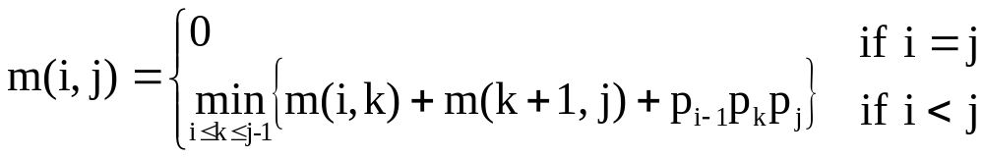
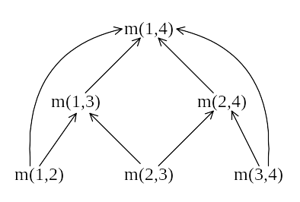
Let m(i, j) denote the minimum cost for computing
A_{i} × A_{i+1} × … × A_{j}
Computation sequence :
Time complexity : O(n³)
7 -<number>

Slide 15
Constructing Optimal Solution
Our algorithm computes the minimum-cost table m and the split table s
The optimal solution can be constructed from the split table s
  Each entry s[i, j ]=k shows where to split the product A_{i} A_{i+1} … A_{j} for the minimum cost

Slide 16
Example 1 - 1
Show how to multiply this matrix chain optimally
Solution on the board
  Minimum cost 124
  Optimal parenthesization (((A₁A₂)A₃)A₄)
Matrix | Dimension
A₁ | 2×3
A₂ | 3×6
A₃ | 6×4
A₄ | 4×5

Slide 17
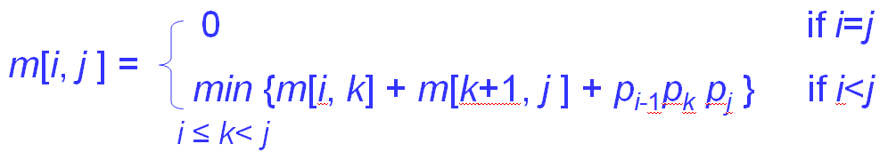
Example 1 - 2
1 | 2 | 3 | 4
2x3 | 3x6 | 6x4 | 4x5
m[I,j] will be calculated for length =1,2,3,4 in order below:
Length = 1: All m[i,i] = 0
2: (1), (2) and (3)
3: (4) and (5)
4: (6)
 | 1 | 2 | 3 | 4
1 | 0 | (1) | (4) | (6)
2 |  | 0 | (2) | (5)
3 |  |  | 0 | (3)
4 |  |  |  | 0

Slide 18
Example 1 - 3
1 | 2 | 3 | 4
2x3 | 3x6 | 6x4 | 4x5
Length = 2: m[1,2] = 2x3x6 = 36, m[2,3] = 3x6x4 = 72, m[3,4] = 6x4x5 = 120
Length = 3:
m[1,3] = min {a,b} where:
a = m[1,1] + m[2,3] + 2x3x4 = 96
b = m[1,2] + m[3,3] + 2x6x4 = 84
Thus m[1,3] = min {96,84} = 84
m[2,4] = min {u,v} where:
u = m[2,2] + m[3,4]+3x6x5 = 210
v = m[2,3] + m[3,3] + 3x4x5 = 132
Thus m[2,4] = min{210,132}= 132
Length = 4:
m[1,4] = min {x,y,z} where:
x = m[1,1] + m[2,4] + 2x3x5 = 132 + 30 = 162
y = m[1,2] + m[3,4] + 2x6x5 = 36 + 120 + 60 = 216
z = m[1,3] + m[4,4] + 2x4x5 = 84 + 40 = 124
Thus m[1,4] = min {162,216,124} = 124
Optimal solution:
(((1,2),3),4)

Slide 19
Example 1 - 4
1 | 2 | 3 | 4
2x3 | 3x6 | 6x4 | 4x5
 | 1 | 2 | 3 | 4
1 | 0 | 36 | (1,2)3 84 | ((1,2)3)4 124
2 |  | 0 | 72 | (2,3)4 132
3 |  |  | 0 | 120
4 |  |  |  | 0

Slide 20
Example 2
Show how to multiply this matrix chain optimally
Solution on the board
  Minimum cost 15,125
  Optimal parenthesization ((A₁(A₂A₃))((A₄ A₅)A₆))
Matrix | Dimension
A₁ | 30×35
A₂ | 35×15
A₃ | 15×5
A₄ | 5×10
A₅ | 10×20
A₆ | 20×25

Slide 21
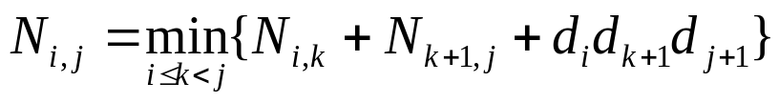
Algorithm Visualization
The bottom-up construction fills in the N array by diagonals
N_{i,j} gets values from previous entries in i-th row and j-th column
Filling in each entry in the N table takes O(n) time.
Total run time: O(n³)
Getting actual parenthesization can be done by remembering “k” for each N entry
answer
N
0
1
2
i
j
…
n-1
0
1
…
i
j
n-1
In this example: N_{i,j} = m[I,j], d_{i} = p_{i-1}

Slide 22
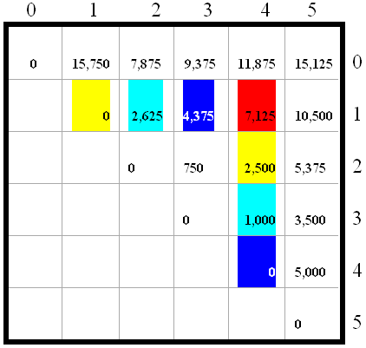
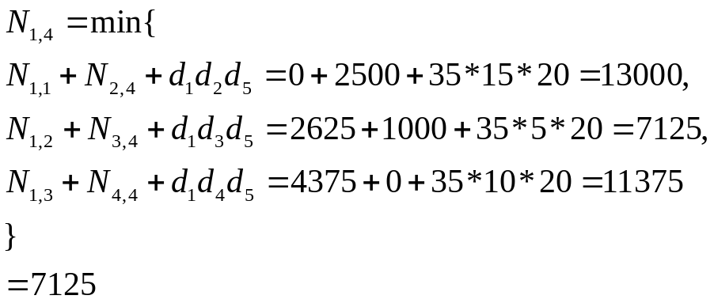
Algorithm Visualization
A₀: 30 X 35; A₁: 35 X15; A₂: 15X5;
A₃: 5X10; A₄: 10X20; A₅: 20 X 25

Slide 23
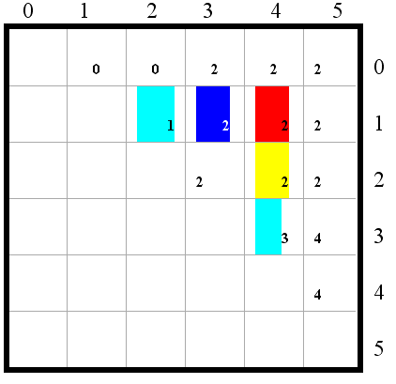
Algorithm Visualization
(A₀*(A₁*A₂))*((A₃*A₄)*A₅)

Slide 24
Matrix Chain-Products
Some final thoughts
  We reduced replaced a O(2^{n}) algorithm with a Θ(n³) algorithm.
  While the generic top-down recursive algorithm would have solved O(2^{n}) sub-problems, there are Θ(n²) sub-problems.
    Implies a high overlap of sub-problems.
  The sub-problems are independent:
    Solution to A₀A₁…A_{k} is independent of the solution to A_{k+1}…A_{n}.

Slide 25
Matrix Chain-Products Summary
Determine the cost of each pair-wise multiplication, then the minimum cost of multiplying three consecutive matrices (2 possible choices), using the pre-computed costs for two matrices.
Repeat until we compute the minimum cost of all n matrices using the costs of the minimum n-1 matrix product costs.
  n-1 possible choices.

